Slide 1


W3C Web of Things & OGC SensorThings API How they can work together and benefit from each other
Michael Jacoby (Fraunhofer IOSB), Hylke van der Schaaf (Fraunhofer IOSB),
Josh Lieberman (OGC), Kathi Schleidt (DataCove e.U.)
Munich, 05.06.2019

Slide 2
AGENDA
What is OGC SensorThings API (STA) and how does it work?
How do WoT and STA relate?
How can WoT benefit from STA?
How can STA benefit from WoT?

Slide 3

What is the OGC SensorThings API?
Free & open web-based API for managing IoT devices
Focus on sensors and observations
Motivated by previous OGC standards like SWE, SOS, SPS, O&M
Technical Aspects
HTTP/RESTful
MQTT
JSON
Adapting OData URL patterns and query options
Relevance
(Open-source) implementations for server and client available
High visibility in environmental sensing and smart city communities
Many systems already deployed
Often with (tens of) millions of observations
https://www.opengeospatial.org/standards/sensorthings

Slide 4
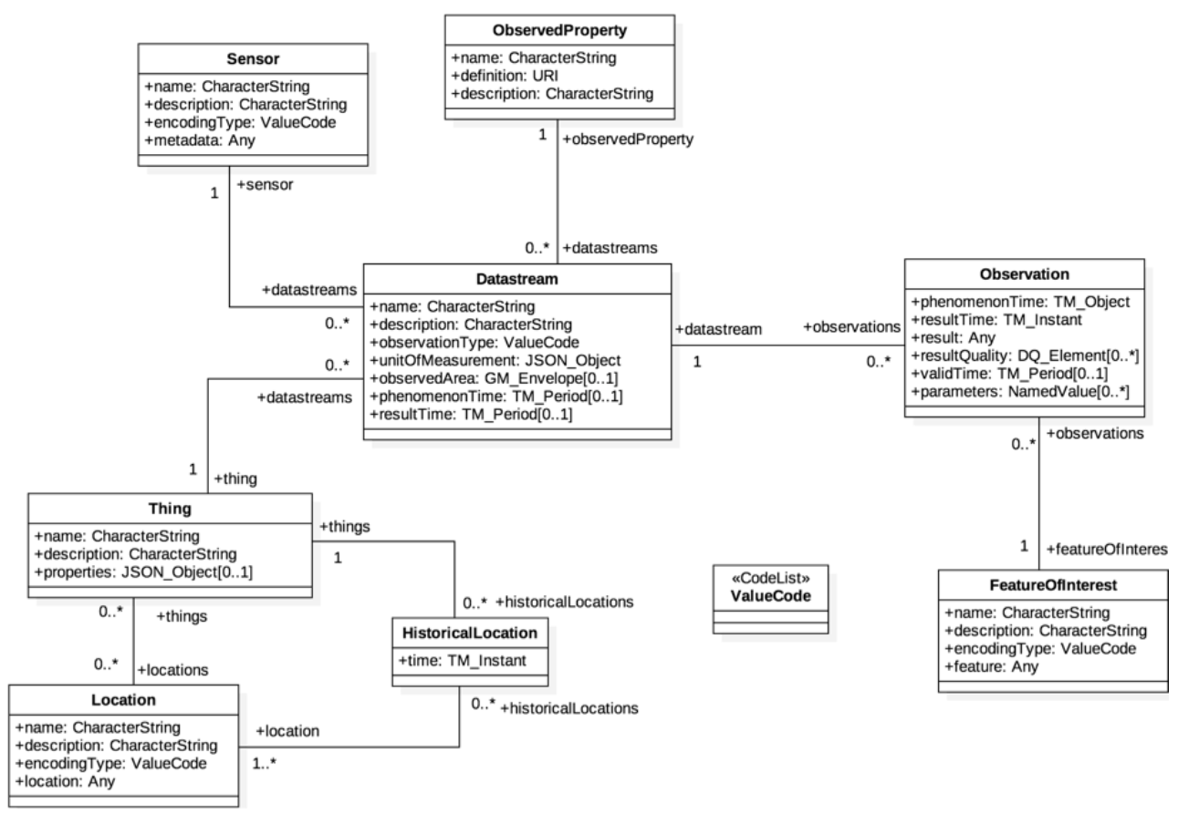
STA Data Model

Slide 5
STA Basics – Accessing Entities
HTTP GET http://example.org/SensorThingsService/v1.0/Things(1)
Response
{
"@iot.id" : 1,
"name" : "Room S021",
"description" : "This is room S021",
"properties" : {
"roomNumber" : "S021",
"numberOfSeats" : "4"
},
"Locations@iot.navigationLink" : "Things(1)/Locations",
"HistoricalLocations@iot.navigationLink" : "Things(1)/HistoricalLocations",
"Datastreams@iot.navigationLink" : "Things(1)/Datastreams",
"@iot.selfLink" : "/SensorThingsService/v1.0/Things(1)"
}

Slide 6
STA Basics – Using Links
HTTP GET http://example.org/SensorThingsService/v1.0/Things(17)? $select=@iot.id,description& $expand=Datastreams($select=@iot.id,description)
Response
{
"description" : "camping lantern",
"@iot.id" : 17,
"Datastreams" : [
{
"description" : "Temperature measurement",
"@iot.id" : 19
},
{
"description" : "Humidity measurement",
"@iot.id" : 21
}
]
}

Slide 7
STA Basics – Filtering
HTTP GET http://example.org/SensorThingsService/v1.0/Observations? $filter=result gt 5
Response:
{
"@iot.count" : 8,
"@iot.nextLink" : "/v1.0/Observations?$filter=result gt 5&$top=4&$skip=4",
"value" : [
{
"phenomenonTime" : "2016-06-22T13:21:31.144Z",
"resultTime" : null,
"result" : 10,
"@iot.id" : 34,
"@iot.selfLink" : "/SensorThingsService/v1.0/Observations(34)"
}, {
…
}, {
…
}, {
…
}
]
}

Slide 8
How do WoT and STA relate?
WoT
Meta-level/API description
Communication protocol-agnostic
Paradigm: state-based
STA
Tailored to sensing & actuation domain
Concrete communication protocols
Paradigm: state-based (meta-data), observation-based
→ Rather complementary than competitive

Slide 9
How can WoT benefit from STA?
STA as use case for TD
New requirements for TD, e.g.
Linking between (collections) of Things
Recursive datatypes
Embrace (geospatial) nature of data
Geospatial information as part of WoT?
Pattern for historic values?
Resource discovery and resource access
Querying data and metadata within same query (ThingDirectory)
Efficient resource access using $expand (ThingDirectory, Scripting API)

Slide 10
STA Entity as WoT TD
{
"@context": { "ex": "http://example.com/myModel/" },
"name": "Room S021",
"@type": ["Thing", "ex:Room"],
"id": "http://example.com/STA/v1.0/Things(1)",
"properties": {
"temperature": {
"@type": "ex:roomTemperature",
"label": "room temperature in S021",
"type": "number",
"readOnly": true,
"forms": [ {
"href": "http://example.com/STA/v1.0/Observations?$filter= Datastream/Thing/id eq 1 and Datastream/ObservedProperty/name eq 'temperature'& $orderBy=resultTime desc&$top=1&
$select=result",
"mediaType": "application/json"
}]
}
}
}

Slide 11
How can STA benefit from WoT?
Additional semantic
Use Semantic Web technologies
Domain-/Application-specific data models
Interoperability and Federations
Expose Things across multiple STA servers in a unified way
Interoperability with other systems/devices

Slide 12
Discussion & Questions

